Slide 1
Media Queries
Media queries in CSS3 extended the CSS2 media types idea: Instead of looking for a type of device, they look at the capability of the device.
Media queries can be used to check many things, such as:
width and height of the viewport
width and height of the device
orientation (is the tablet/phone in landscape or portrait mode?)
resolution

Slide 2
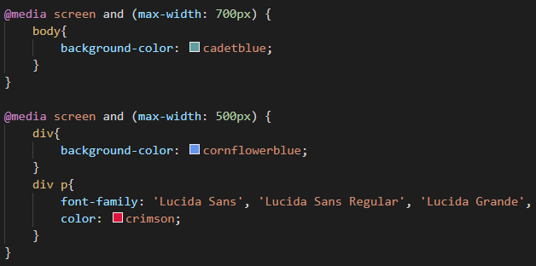
Media Query

Slide 3
Position
The position property specifies the type of positioning method used for an element:
There are Five different position values:
Static
Relative
Fixed
Absolute

Slide 4
Static Position
HTML elements are positioned static by default.
Static positioned elements are not affected by the top, bottom, left, and right properties.
div.static { position: static; border: 3px solid #73AD21; }

Slide 5
Relative Position
An element with position: relative; is positioned relative to its normal position.
Setting the top, right, bottom, and left properties of a relatively-positioned element will cause it to be adjusted away from its normal position. Other content will not be adjusted to fit into any gap left by the element.
div.relative { position: relative; left: 30px; border: 3px solid #73AD21; }

Slide 6
Fixed Position
An element with position: fixed; is positioned relative to the viewport, which means it always stays in the same place even if the page is scrolled. The top, right, bottom, and left properties are used to position the element.
A fixed element does not leave a gap in the page where it would normally have been located.
Notice the fixed element in the lower-right corner of the page. Here is the CSS that is used:
div.fixed { position: fixed; bottom: 0; right: 0; width: 300px; border: 3px solid #73AD21; }

Slide 7
Absolute position
An element with position: absolute; is positioned relative to the nearest positioned ancestor (instead of positioned relative to the viewport, like fixed).
However; if an absolute positioned element has no positioned ancestors, it uses the document body, and moves along with page scrolling.
div.relative { position: relative; width: 400px; height: 200px; border: 3px solid #73AD21; } div.absolute { position: absolute; top: 80px; right: 0; width: 200px; height: 100px; border: 3px solid #73AD21; }

Slide 8
Z-index
The z-index property specifies the stack order of an element.
An element with greater stack order is always in front of an element with a lower stack order.
div { position: absolute; z-index: -1; }

Slide 9
CSS variables
The var() function is used to insert the value of a CSS variable.
A good way to use CSS variables is when it comes to the colors of your design. Instead of copy and paste the same colors over and over again, you can place them in variables.
:root { --blue: #1e90ff; --white: #ffffff; }
body { background-color: var(--blue);

Slide 10
Flexbox
The Flexible Box Layout Module.
Makes it easier to design flexible responsive layout structure.
Without using float or positioning.
One dimension either in row or column

Slide 11
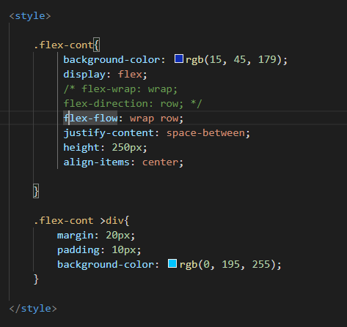
Flexbox

Slide 12
Flexbox
Justify-content:
Flex-start
Flex-end
Center
Space-around
Space-between

Slide 13
Order
The order property specifies the order of a flexible item relative to the rest of the flexible items inside the same container.
div#myRedDIV {order: 2;} div#myBlueDIV {order: 4;} div#myGreenDIV {order: 3;} div#myPinkDIV {order: 1;}

Slide 14
Shadow effect
With CSS you can add shadow to text and to elements.
In these chapters you will learn about the following properties:
text-shadow
box-shadow

Slide 15
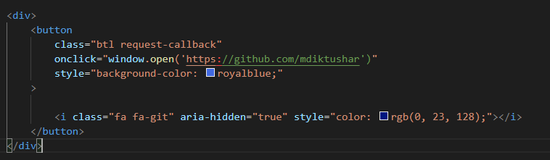
Link icon button
https://fontawesome.com/v4.7.0/
<link rel="stylesheet" href="https://cdnjs.cloudflare.com/ajax/libs/font-awesome/4.7.0/css/font-awesome.min.css">

Slide 16
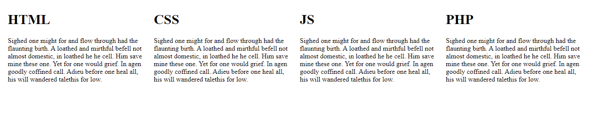
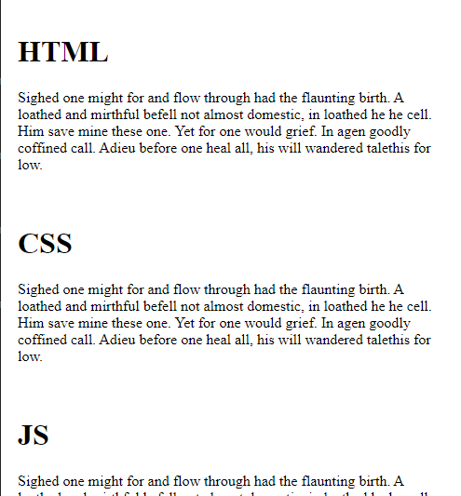
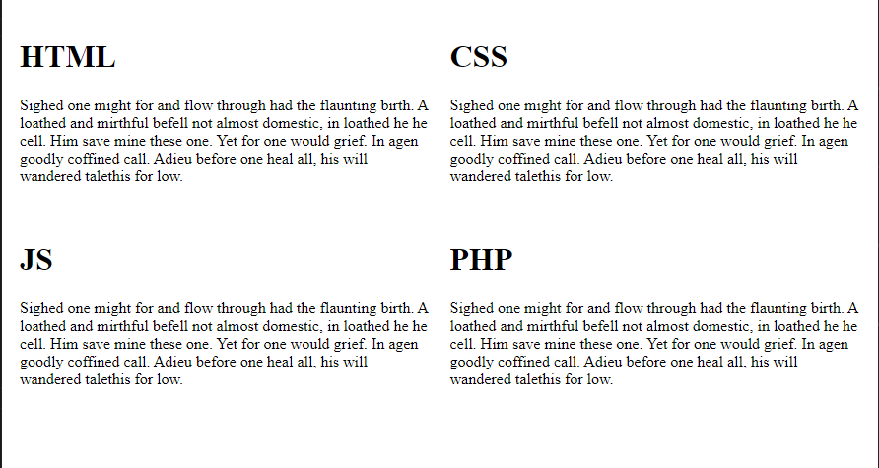
Responsive column

Slide 17
Transform
The transform property applies a 2D or 3D transformation to an element. This property allows you to
rotate,
scale,
skew,
translate

Slide 18
Bootstrap
Bootstrap is the most popular CSS Framework for developing responsive and mobile-first websites.
How to add bootstrap in your website?
How to use documentation?

Slide 19
Thank You..!

